Slide 1

Praat Scripting
Introduction
&
Crash course on file management scripting

Slide 2
Goals
Overview of Praat scripting
Basic fundamentals
Create a script from your Praat history
For-Loops
Boilerplate code
Modify a script!
Goals:
Get number of .wav files in a directory
Print out individual file names
Get duration of each .wav file
Bonus goals:
Get total duration of all .wav files
Copy all .wav files ending in "_3" to a new directory and append "_copy" to the file name
Toggle option to "clean up" as you go

Slide 3
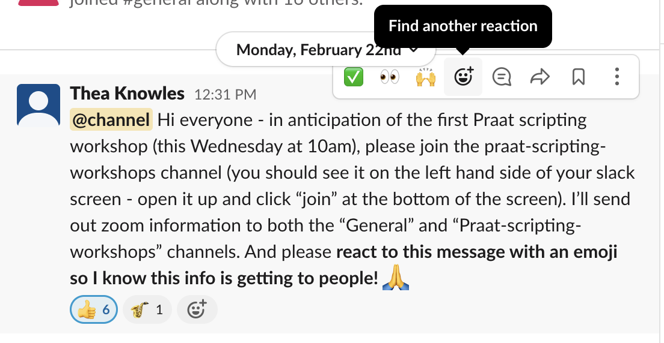
Preliminaries: Slack
In the workshop:
Use Slack during the “hands-on” components to ask questions, post screenshots, etc.
Long-term goal:
Troubleshoot with other UB Praat users!
”React” to things on Slack:
I will ask you to do this during the hands-on so I know when you’re ready to move on

Slide 4

This is a choose-your-own-adventure workshop
Fundamentals together
Hands-on: choose the level of difficulty you want to try
Assumptions for today:
At least some familiarity with Praat

Slide 5
Overview of Praat scripting. Why?

Slide 6
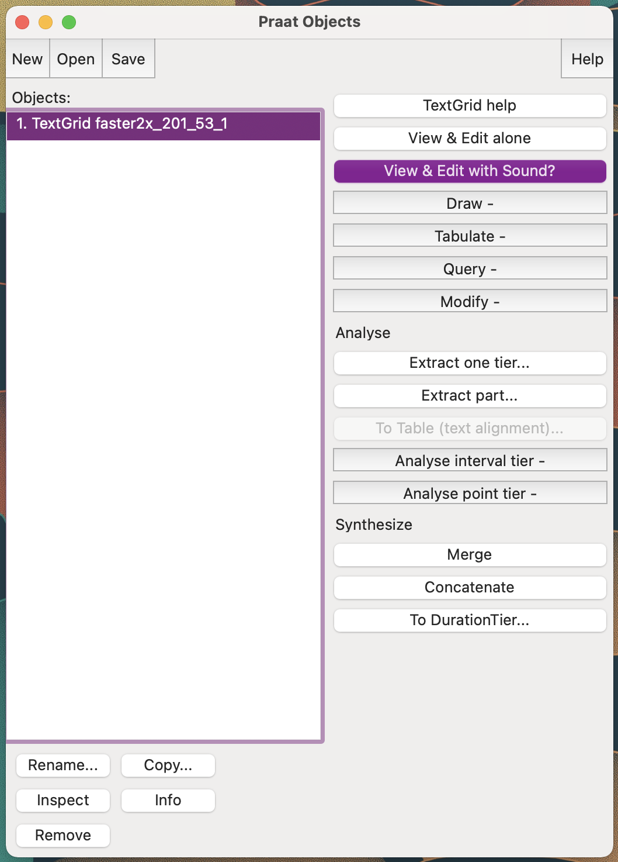
Using Praat
Can accomplish a lot by
Clicking buttons
Selecting menu items
Entering information into forms

Slide 7
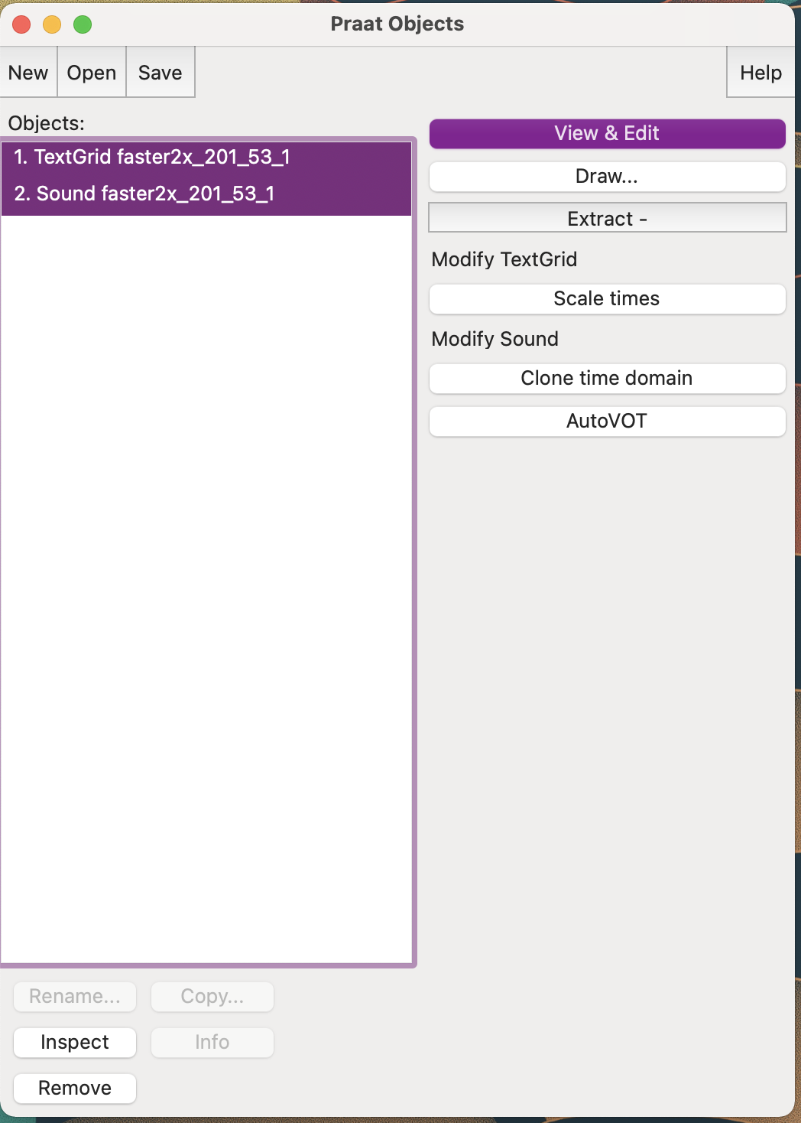
Using Praat
Example of things we do a lot in my lab:
Find folder with files to annotate
Open TextGrid/wav pair in Praat
Select them both
View & edit together
Annotate TextGrid
Save TextGrid
We start off learning to do this by hand
Then we use Praat scripts to do a lot of the repetitive tasks for us

Slide 8
With Praat scripts you can…
Automate repetitive tasks like…
opening/closing/saving files
Saves a lot of time (once you get the basics down)!
Have consistent, replicable measurements
Minimize human error in data preparation
Keep a careful log of how you did your analyses
Code = instructions

Slide 9
Use your knowledge of Praat to write scripts
A frequent routine of mine:
Copy old boilerplate from old script to new script
Add comments to top with brief description of script
Add some stuff
Test (run) script a lot (almost every line)
Force script to crash at relevant points
Lots and lots and lots of printing to the Praat info window as sanity check
When I can’t remember function/argument structure, try to do it manually in Praat to see what it looks like
Praat history function
(lots of) Googling + Praat scripting manual

Slide 10
Basic fundamentals

Slide 11
Some terminology
Coding: Writing in a language a computer can understand
Scripting: A type of coding that tells a specific program exactly what actions to take
Programming: Writing code that serves to actually create another program (an app, software, etc)
Scripts: Text files containing code.
Scripting, coding, and programming are sometimes used interchangeably

Slide 12
What is a script?
Sequentially ordered set of instructions that are given to a program that can interpret & execute them
Must be written in the program’s language (syntax)
Praat script
R script
Etc.

Slide 13
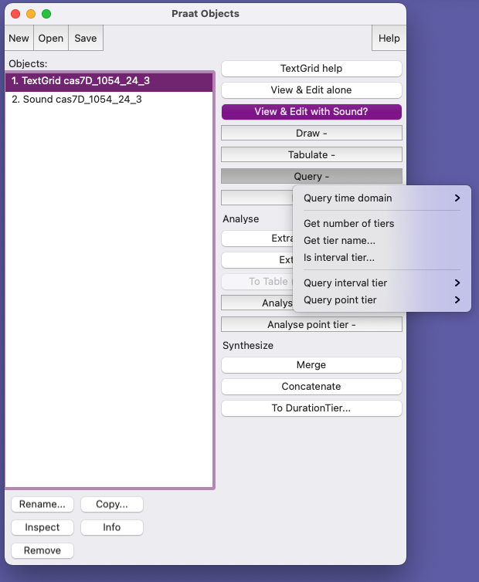
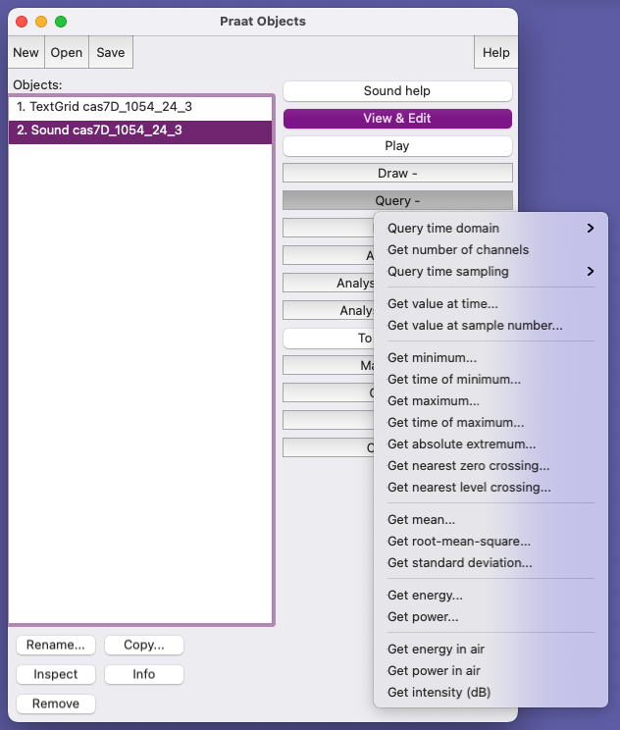
Commands & Built-in Functions in Praat
Commands in Praat: Instructions you give to Praat (aka - the buttons you click!)
Dependent on object type
Sound vs. TextGrids vs. Strings, etc
Written as-appears in Praat
Start with capital letter
Arguments given in order you would type them in Praat
Read more: https://praatscripting.lingphon.net/commands.html

Slide 14
Commands & Built-in Functions in Praat
Built-in Functions: Instructions that don’t have a corresponding Praat button like selectObject, clearinfo, fileReadable()…
Human action
Starts with lower case
Read more: https://praatscripting.lingphon.net/commands.html

Slide 15
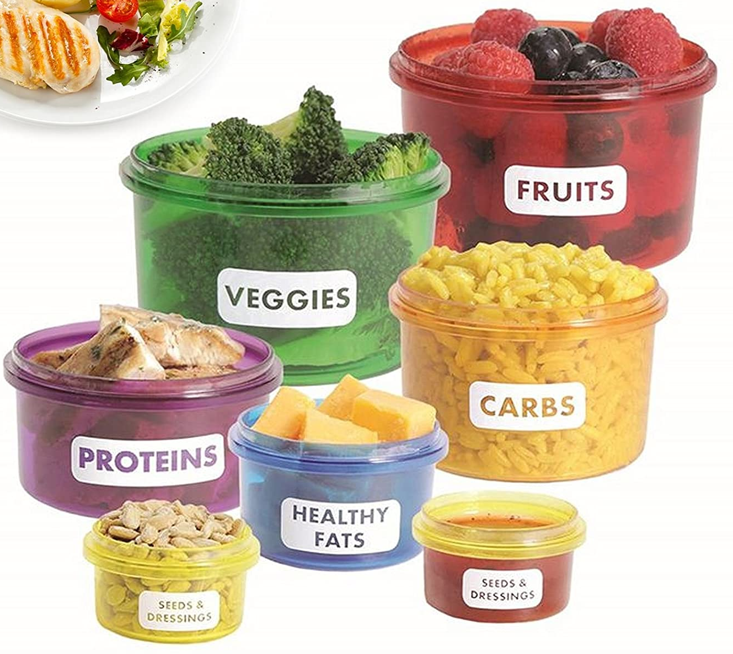
Variables
In programming, a variable is a place in the computer’s memory where something is stored → containers
It has a name & value
Value is assigned to the name like this:
name = value
veggies = broccoli
proteins = chicken
Notes:
Some variables exist in Praat by default
Can be CHANGED depending on what you assign them

Slide 16
Variables
Value is assigned to the name like this:
name = value
In Praat, Names must start with lowercase and have only letters, digits, and underscores
Valid variables | Invalid variables
num = 2 my_num = 2 myNum = 2 n = 2 akjl_123 = 2 | Num = 2 my num = 2 my-num = 2 _n = 2 2 = 2
Variable names don’t HAVE to be informative, but your life will be easier if they are
Notes:
Some variables exist in Praat by default
We use variables so we can more easily control/modify them when we run the script

Slide 17
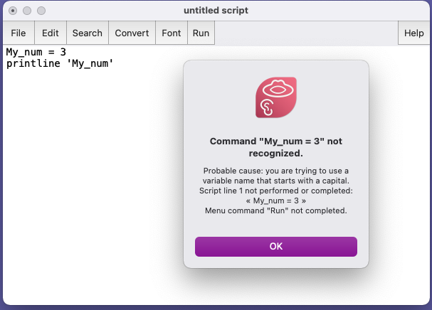
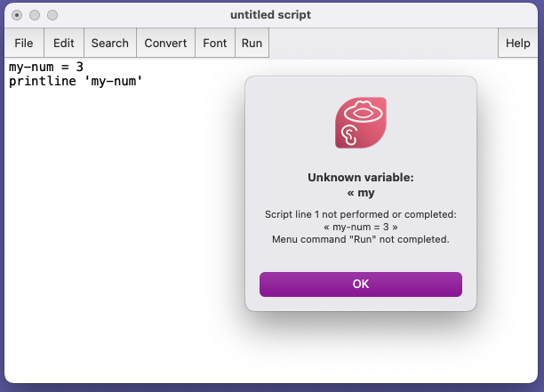

Slide 18
Variable types in Praat
Common types: numeric (number) and string (text)
my_number = 42
my_other_number = 1.0001
my_text$ = “3”
my_other_text$ = “hello!”
Learn more:
https://praatscripting.lingphon.net/variables-1.html
https://www.fon.hum.uva.nl/praat/manual/Scripting_5_1__Variables.html
String variable names in Praat must end with “$”
String variable values must be in
“ ”
Notes:
Think of default "variable" in Praat as numeric
BUT you can make it a string!

Slide 19
Praat syntactic structure: Considerations
One complete statement per line
When you run a script, lines are executed in order
If Praat runs into a line it can’t interpret, it will crash + output an error
Use Praat GUI to help you learn the syntax
Whitespace ignored, but helpful to you
Notes:
If you want to split a command over multiple lines you can use an ellipsis at the beginning of sequential lines

Slide 20
# Comments
Comments:
notes to user that Praat will ignore (not try to run)
Statements you want Praat to ignore for now
Must start with “#” and appear on separate lines OR
Start with “;” and
# This is a comment and won’t be run
; This is a comment and won’t be run
my_num = 2; This is a comment and won’t be run

Slide 21
Understanding Praat errors
Description of error + line number where the script crashed
Look at the line in your script: Search >> Go to line… (or cmd + L)
Common sources of error:
Incorrect capitalization
Incorrect use of quotes
Incorrect type of object selected

Slide 22
Types of errors
Syntactic errors
Typos, incorrect use of quotes, etc.
Runtime errors
Impossible for Praat to do as told: file doesn’t exist, command doesn’t exist for that object type, etc.
Object types: Sound, TextGrid, Strings, etc (see more about Praat Object types)
Semantic errors
Praat does what you tell it, but the output is not what you want
Sneaky! Doesn’t produce an error! Need to frequently test your code to avoid these!
Notes:
https://www.linguisticsociety.org/sites/default/files/e-learning/Day1.pdf

Slide 23
printline statements in Praat: Get Praat to tell you things
printline: special type of function in Praat that prints whatever follows it to the Praat info window
To print… | Do… | Example code
Verbatim text | Just type it! | printline hello world
Variables | Use single quotes | printline ‘filename$’ printline The value is ‘my_num’
Numeric variables with limited place decimlas | Limit decimals with “:” | printline The value is ‘my_num:4’
NOTE: writeInfoLine: “some text” and appendInfoLine: “more text” do similar things & reflect more recent syntax:
https://www.fon.hum.uva.nl/praat/manual/Scripting_6_2__Writing_to_the_Info_window.html

Slide 24
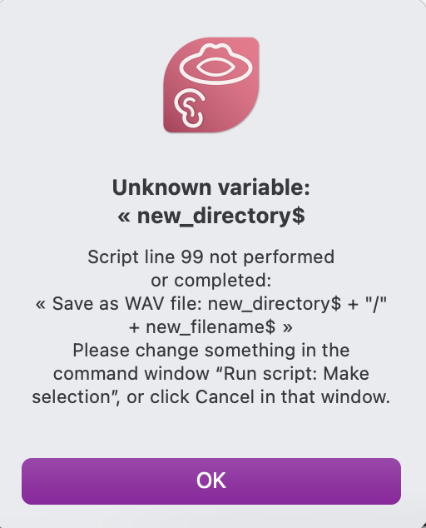
Error example: Unknown variable
How to debug:
Go to line error in Script (99): Search >> Go to line
Look further up for where that variable was created
Use printline statements earlier if you’re unsure what it contains
Forgot to assign the variable “new_directory$” which Praat tried to use on line 99
OR
Assigned it but left off the “$”
OR
Assigned it but with a typo in the name

Slide 25
Referring to variables
When referring to variables as arguments in Praat commands, no quotes
Read from file: current_file$
When referring to variables in built-in Praat functions, single quotes needed
selectObject: “Sound” + ‘filename$’
printline ‘filename$’
Verbatim arguments in double quotes (usually)
Notes:
”Sound” = NOT a variable! This is a verbatim argument

Slide 26

Hands-on

Slide 27

Hands-on
Let’s try out some commands
Do some stuff in Praat by clicking menu items/buttons
Print our history to see how these actions should be coded
Turn them into a script
Everybody: Open Praat

Slide 28
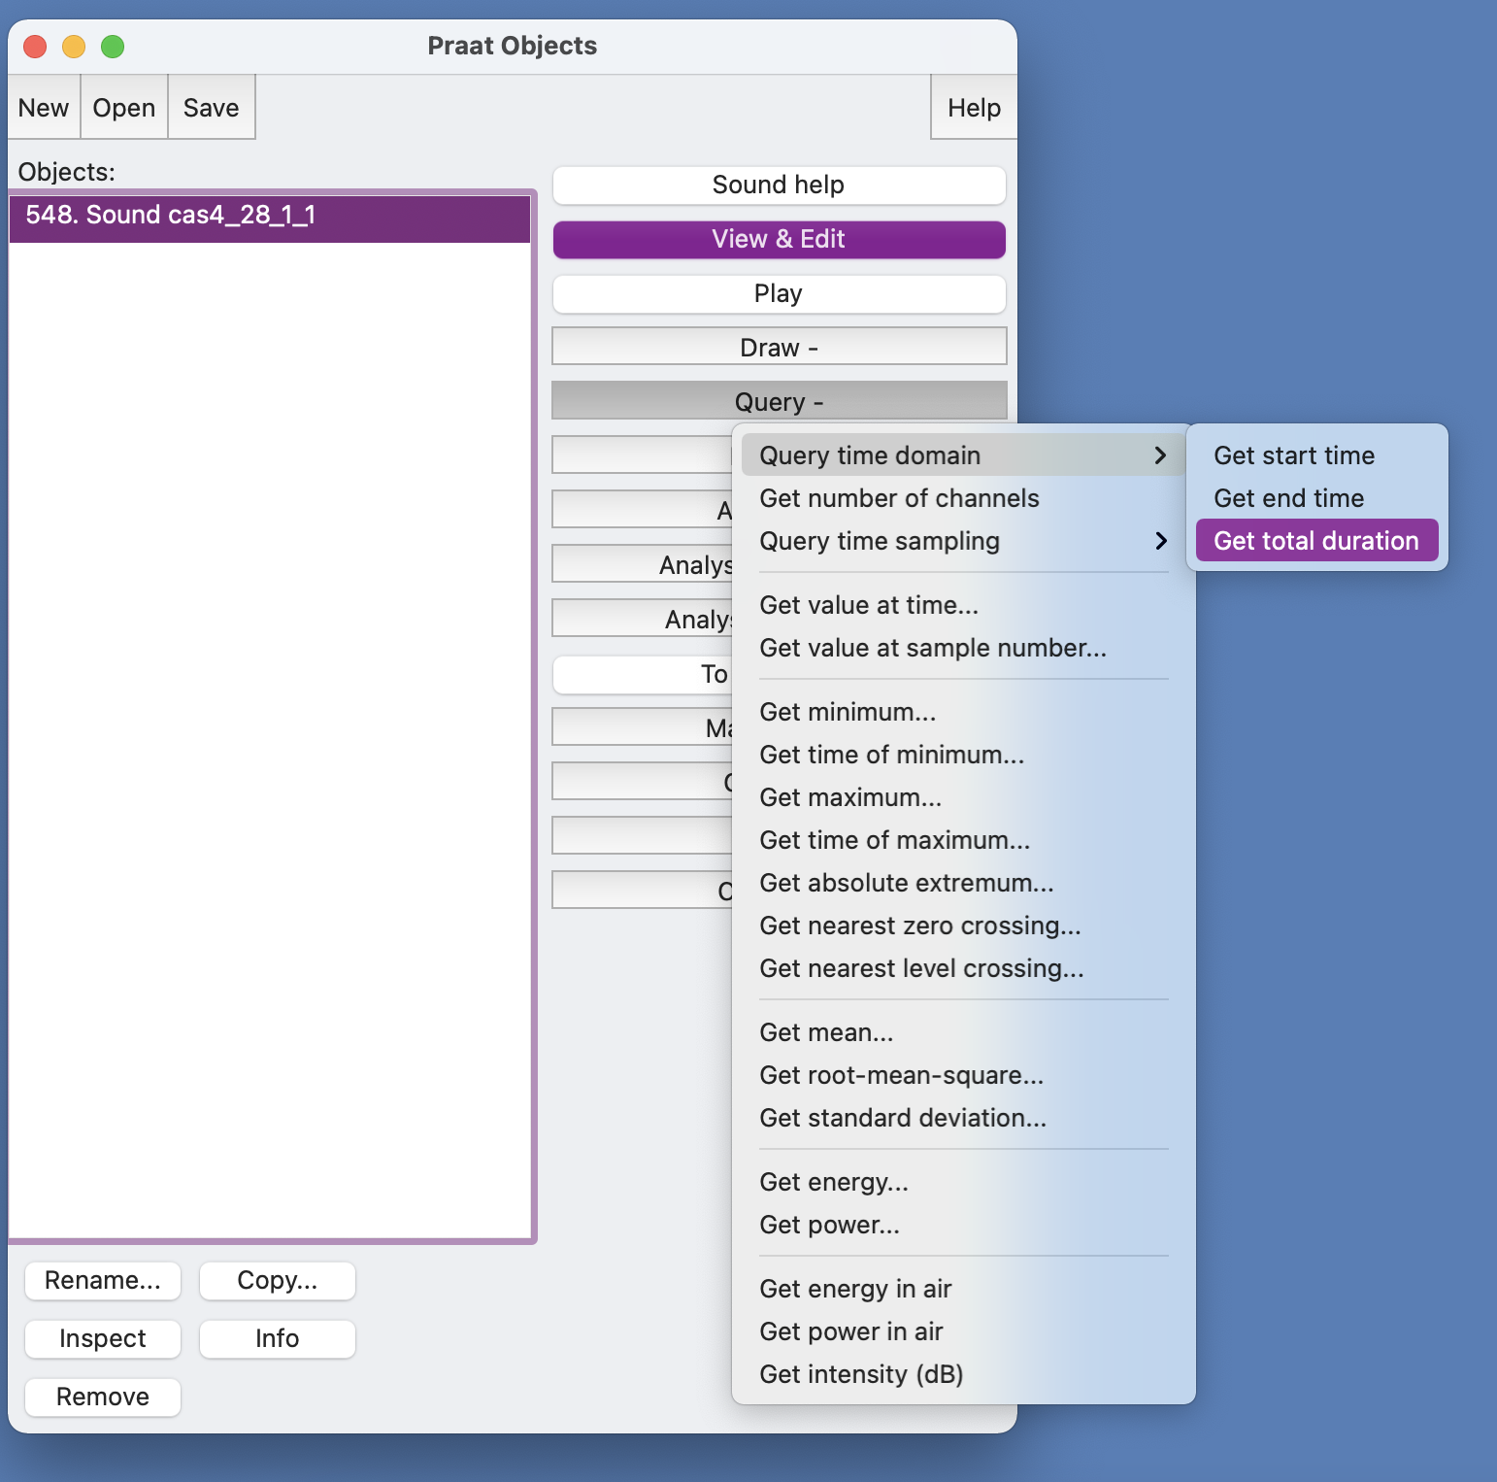
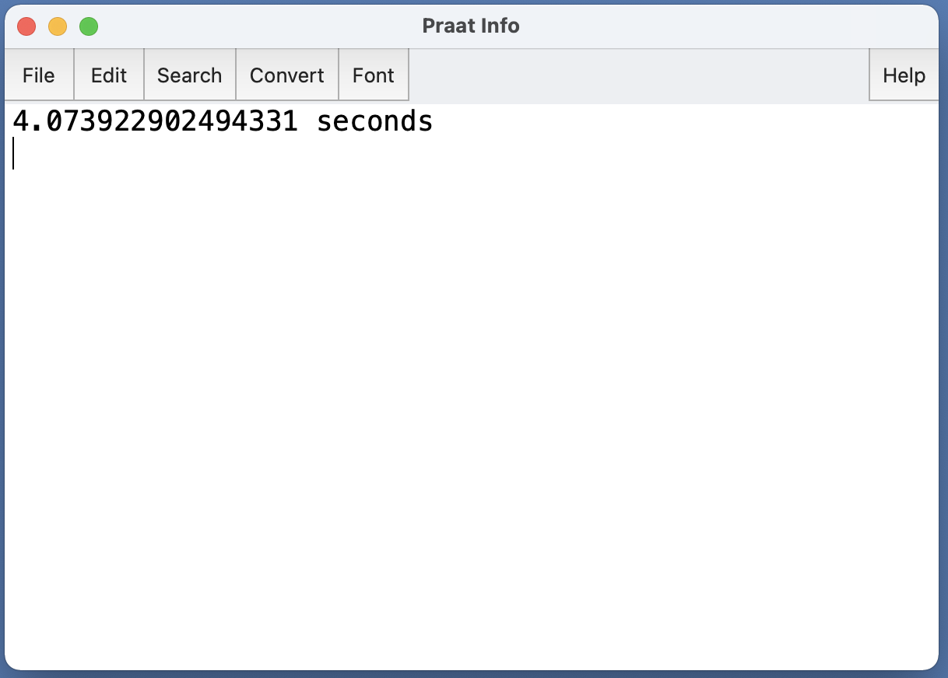
Get duration of .wav file
Open one of the .wav files in data/ in Praat
Get it’s duration using the Query menu

Slide 29
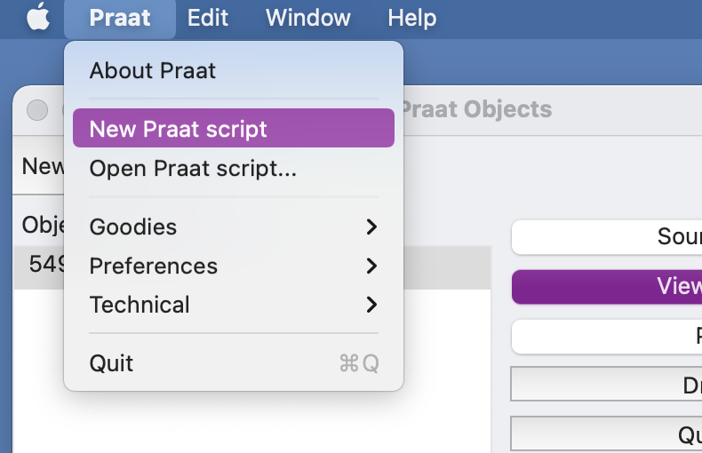
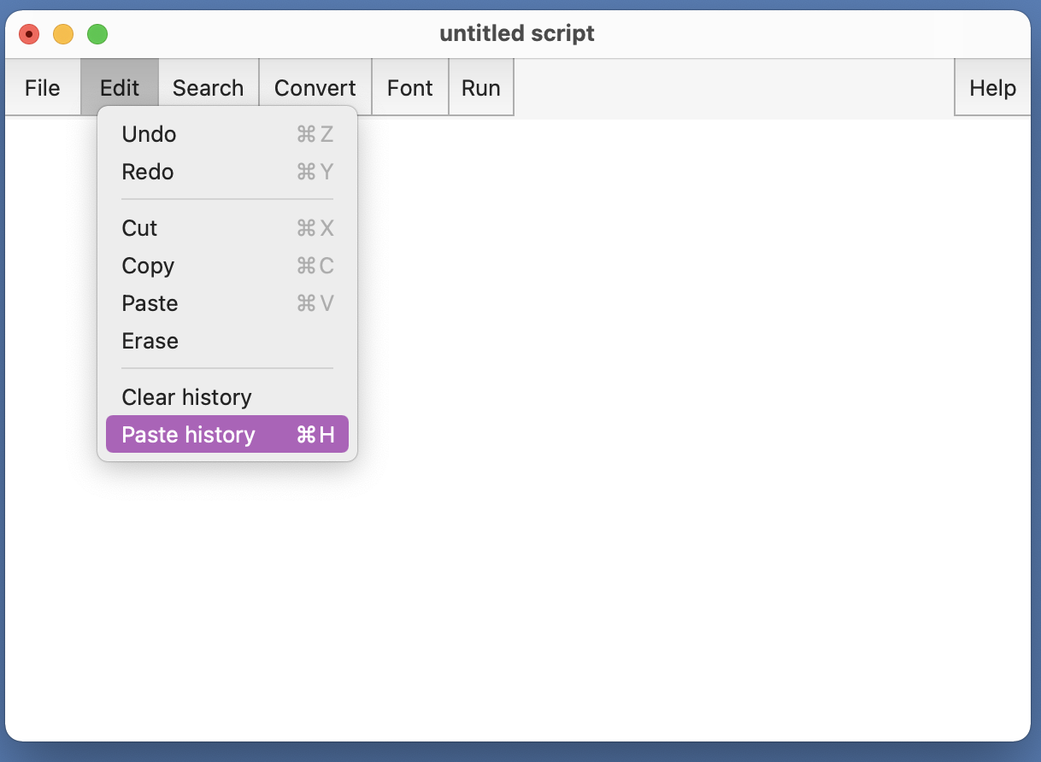
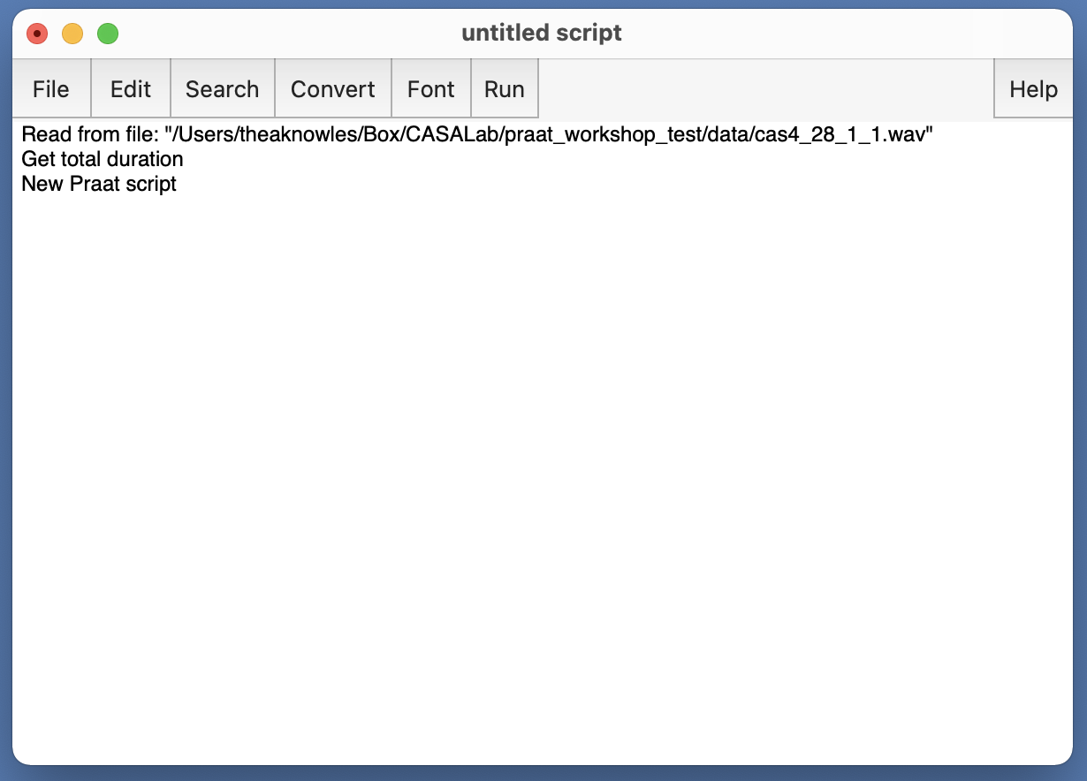
Print command history in new Praat scripting window

Slide 30
Save as test.praat & run!
We will be testing out our code a LOT
Testing:
Running code
Breaking code (often intentionally)

Slide 31
Save as test.praat and run the “script”
2 minutes
Now we’ll edit your script by doing the following…
Delete the “New Praat Script” command
Store the “total duration” to a variable named “total_dur”
total_dur = Get total duration
Add a line to print the value of “total_dur” to the Praat info window using printline
printline ‘total_dur’
Modify the printline statement to be more informative and only print 4 digits
printline The total duration is: ‘total_dur:4’
Add a comment somewhere
# Like this.

Slide 32
What if we want to get the duration of all the .wav files in our folder?
This is where being able to write scripts shines
We can iterate our code with a for-loop
For-loops
Special syntax
Allow us to tell Praat “repeat this code n times”
Other kinds of loops: while-loops, until-loops
for counter from min to max
# code to repeat here
endfor

Slide 33
Let’s level up our script to iterate over all the .wav files in our folder
But first… boilerplate code

Slide 34
Boilerplate code
i.e. your starting template
Code that can be used again and again and again without changing much

Slide 35
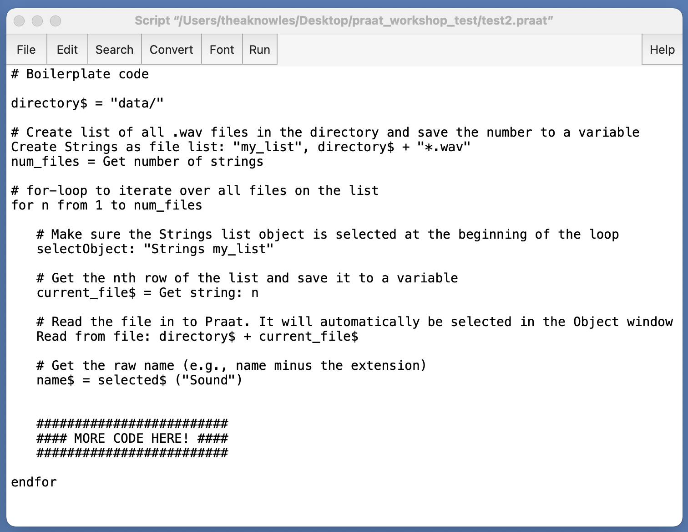
Level up: Using a boiler plate structure
Open boilerplate_code1.praat
Goals:
Add our code to the boiler plate code and get the duration of all .wav files in our folder
Print information to ourselves about the number of files

Slide 36
Comments
Start with #
Won’t get evaluated by Praat

Slide 37
Define path to files
Define the directory path
Paths can be:
Relative to where the script lives
Absolute
Must be text
Variable name ends in ”$”
Value in “ “
Paths must end with backslash /
Notes:
/ vs. \ Mac vs. PC – in current Praat versions this is no longer an issue (I think)
Mistyped paths are probably my most common error type

Slide 38
Get list of files
Create list of all .wav files in directory and count them
“Strings as file list” is a special Praat Strings object used for this purpose

Slide 39
For-loop
Purpose: Iterate over all files on the list and do stuff to each one
Special syntax

Slide 40
For-loop structure:
for counter from min to max
…
endfor
n = arbitrary variable name for counter. +1 each time through the loop
1 = starting point
num_files: number of .wav files in our directory
All code within for-loop should be indented: easier to read/debug

Slide 41
selectObject:
Equivalent to you clicking on the object in the Praat Object window
Built in Praat function
Argument: object type & name as appears in Object window
Important: You must have the correct object selected in order to issue the right commands!
Otherwise: error
Test: try commenting out and see what happens
selectObject: “Strings my_list”
=
select Strings my_list
Notes:
Formerly select
I still use select a lot (it’s in the code)

Slide 42
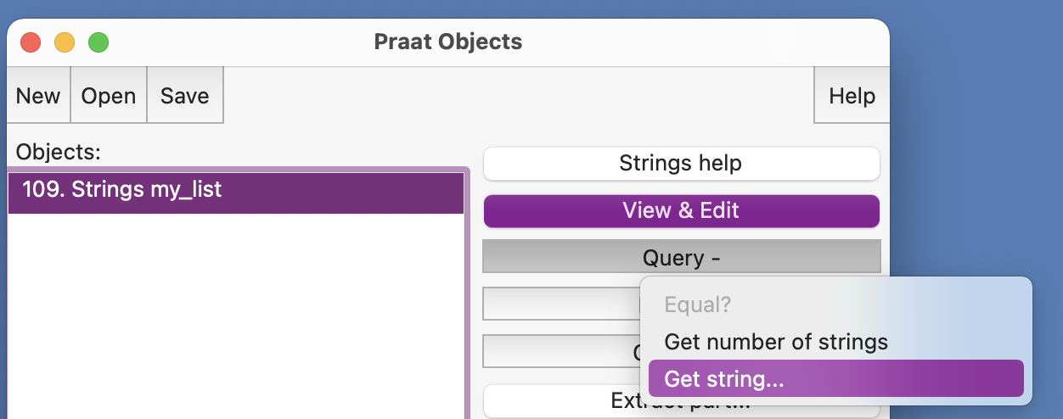
Get string:
Get the nth row of the list of filenames
Praat command (button) available in Object window when a Strings object is selected
Save it to a variable. Notice…
Because it’s text, it is a string (text) variable, so variable name must end in “$”
Argument of “Get string:” the position you want to look at in the list (numeric)
“n” is our counter variable
Notes:
Formerly select

Slide 43
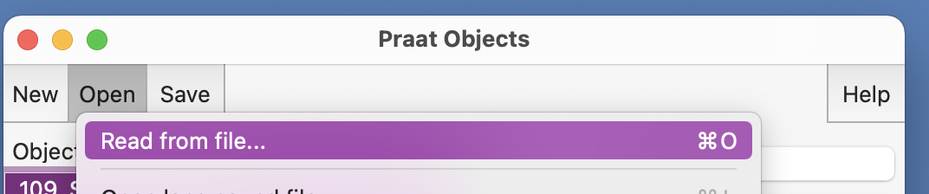
Read from file:
Open the file in Praat
Argument: path to file
This is the value stored in our variable “directory$”!
Notes:
Formerly select

Slide 44
Get name of Object
Once the file is read into Praat it will have an object type and a name
Name is the same as the original filename, minus the extension
Notes:
Formerly select

Slide 45
Hands-on

Slide 46
Goals:
Level 1
Modify boilerplate_code1.praat to print the following information to the screen:
Get number of .wav files in a directory
Print out individual file names
Get duration of each .wav file
Cheat sheets/Answers:
cheat_sheet_level1.praat
Level up: Modify code to:
Level 2: Get total duration of all .wav files
Level 3: Copy all .wav files ending in "_3" to a new directory and append "_copy" to the file name
Level 4: Toggle option to "clean up" as you go
Level 5: Add a form for user input
Cheat sheets:
boilerplate_code2.praat
cheat_sheet_workshop1.praat

Slide 47
Using boilerplate_code1.praat & your Praat history, get the duration of each .wav file in the directory
Save script as something new (e.g., test.praat) before editing.
Save it in the same location as the “data” folder!
Hint: Get the total duration of the Sound object that’s named ‘name$’
Use printline to print it to the screen

Slide 48
Debugging
A few different ways to do it
Force crash
Pause windows
Run selection
My personal favorites:
Include printline statement with variables to inspect & then force script to crash
Other tips:
Go to the line number in the script (Search >> Go to line…” or Cmd + L on Mac)
Google the literal error

Slide 49
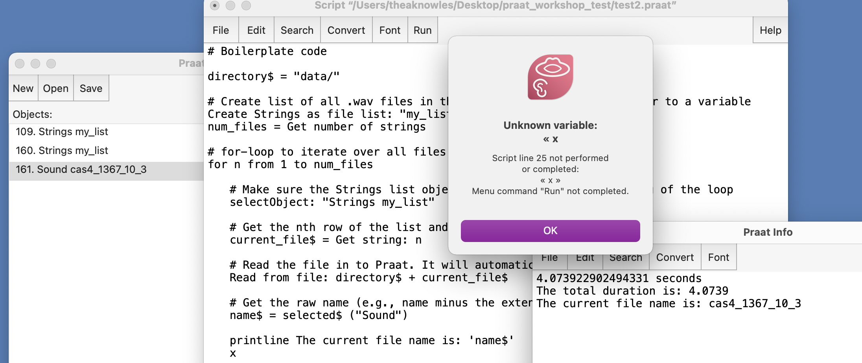
Test: Force Praat to crash in order to inspect your code
Useful printline statement of variables I want to inspect followed ”x”
Praat will get to the “x” and crash
At this point I can see what’s in the Object window, what the most recent variable is… etc.
What kind of error is this?
Notes:
(a random keysmash will also do ☺)

Slide 50
Goals:
5 minutes
Level 1
Modify boilerplate_code1.praat to print the following information to the screen:
Get number of .wav files in a directory
Print out individual file names
Get duration of each .wav file
Cheat sheets/Answers:
cheat_sheet_level1.praat
Level up: Modify code to:
Level 2: Get total duration of all .wav files
Level 3: Copy all .wav files ending in "_3" to a new directory and append "_copy" to the file name
Level 4: Toggle option to "clean up" as you go
Level 5: Add a form for user input
Cheat sheets:
boilerplate_code2.praat
file_management.praat

Slide 51
“Answers”
(i.e., there’s way more than 1 ”correct” way to do these things,
but here’s what I did)

Slide 52
Review cheat_sheet_level1.praat together

Slide 53
Level 2: Get total duration of all .wav files
Hint: set up a dummy numeric variable (e.g., total_dur) as a counter and add to it on each loop
Think: Where in relationship to for-loop should this happen?
# LEVEL 2 (part 1): set up empty numeric variable to sum .wav duration
total_dur = 0
for n from 1 to num_files
…
# LEVEL 2 (part 2): Get total duration of files
total_dur = total_dur + dur
endfor
# LEVEL 2 (part 3): print with 4 decimal places
printline ‘total_dur:4’

Slide 54
Level 3: Copy all .wav files ending in "_3" to a new directory and append "_copy" to the file name
New ingredients:
String functions to get information from file name
https://www.fon.hum.uva.nl/praat/manual/Formulas_6__String_functions.html
Condition (if-statement)
https://praatscripting.lingphon.net/conditionals-1.html
Save as WAV file

Slide 55
Level 3: Copy all .wav files ending in "_3" to a new directory and append "_copy" to the file name
new_directory$ = directory$ + new_folder_name$
…
for n from 1 to num_files
...
# LEVEL 3: Copy all .wav files ending in _3 to new directory & rename
# Get last character of filename
# Source: https://www.fon.hum.uva.nl/praat/manual/Formulas_6__String_functions.html
suffix$ = right$ (filename$,1)
if suffix$ == "3"
select Sound 'filename$’
new_filename$ = filename$ + "_copy.wav"
# Sanity check by using printline
printline 'filename$' suffix: 'suffix$’
# Save file to new location
Save as WAV file: new_directory$ + "/" + new_filename$
endif
endfor

Slide 56
Level 4: Toggle option to "clean up" as you go
New ingredients
Boolean variables (TRUE/FALSE or 1/0)
Conditional (if-statement)
Built-in functions:
select all, minus, clearinfo
“Remove” command

Slide 57
Level 4: Toggle option to "clean up" as you go
First, without toggling
clearinfo
for n from 1 to num_files
...
select all
minus Strings my_list
Remove
endfor
select all
Remove
printline All finished!
Toggle option challenge:
Create Boolean variable
clean_up = 1
Nest your clean up code in if-statements (note syntax)
if clean_up == 1
clearinfo
endif

Slide 58
Level 5: Add a form for user input
Forms: special code chunks that will generate a user input form for the user to provide arguments to the script
Special syntax & behavior
Must declare variable type, name, value differently than in script
https://www.fon.hum.uva.nl/praat/manual/Scripting_6_1__Arguments_to_the_script.html
https://praatscripting.lingphon.net/simpleinput-1.html
My habits:
I usually include a form at the beginning of my script to enter the directory information
For scripts I run myself, I usually don’t do much with the form, but I like to have it as a secondary buffer between me and the rest of the script (“Did I actually mean to Run this?”)
For scripts other people run, I include many other form variables
Annotator ID, task option, verbose option…

Slide 59
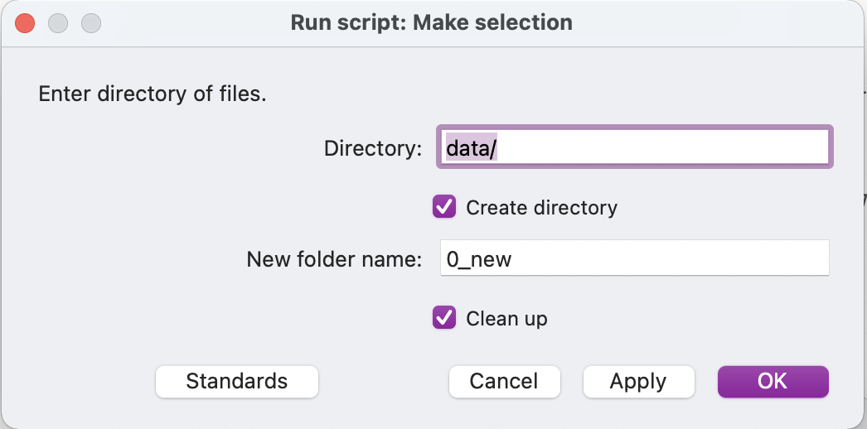
Level 5: Add a form for user input
# LEVEL 5: Forms
# Forms are special kinds of code blocks in Praat
form Make selection
comment Enter directory of files.
sentence Directory data/
boolean Create_directory 1
sentence New_folder_name 0_new
boolean Clean_up 1
endform
This is what pops up when you run the script:

Slide 60
Additional tips

Slide 61
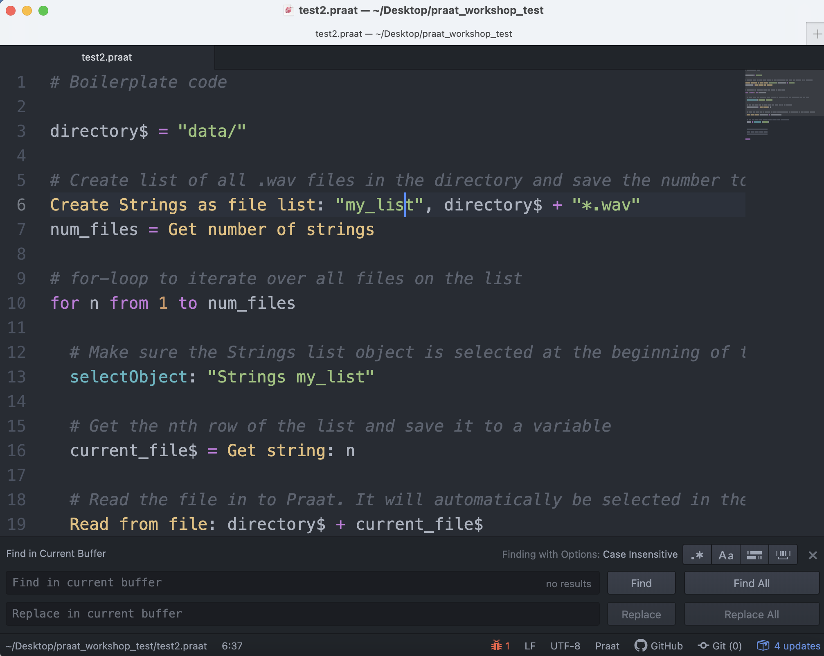
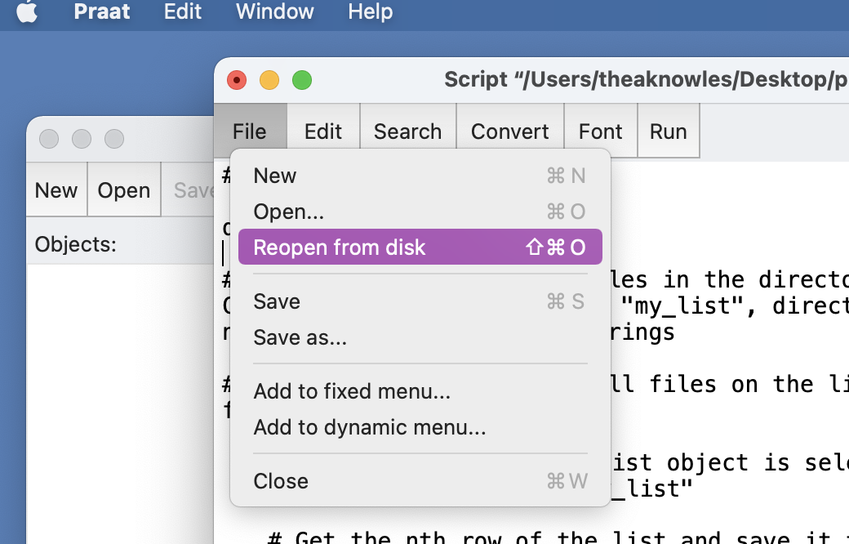
Script editors
Options I like:
Atom + Praat syntax
BBEdit + Praat syntax
My routine:
Edit in text editor of choice (have script also open in Praat)
Switch to Praat script in Praat, and do “Reopen from disk”
Run

Slide 62
Other scripting resources
https://praatscripting.lingphon.net/
https://eleanorchodroff.com/tutorial/PraatScripting.pdf
http://www.mauriciofigueroa.cl/04_scripts/Praat_scripting_manual_0.1.8_04.pdf
https://www.linguisticsociety.org/sites/default/files/e-learning/Day1.pdf
Subscribe to Praat Users group: https://groups.io/g/Praat-Users-List

Slide 63
Other people’s scripts
http://www.acsu.buffalo.edu/~cdicanio/scripts.html
https://lennes.github.io/spect/
https://github.com/stylerw/styler_praat_scripts
http://www.mattwinn.com/praat.html
https://github.com/thealk/PraatScripts

